Slide 1
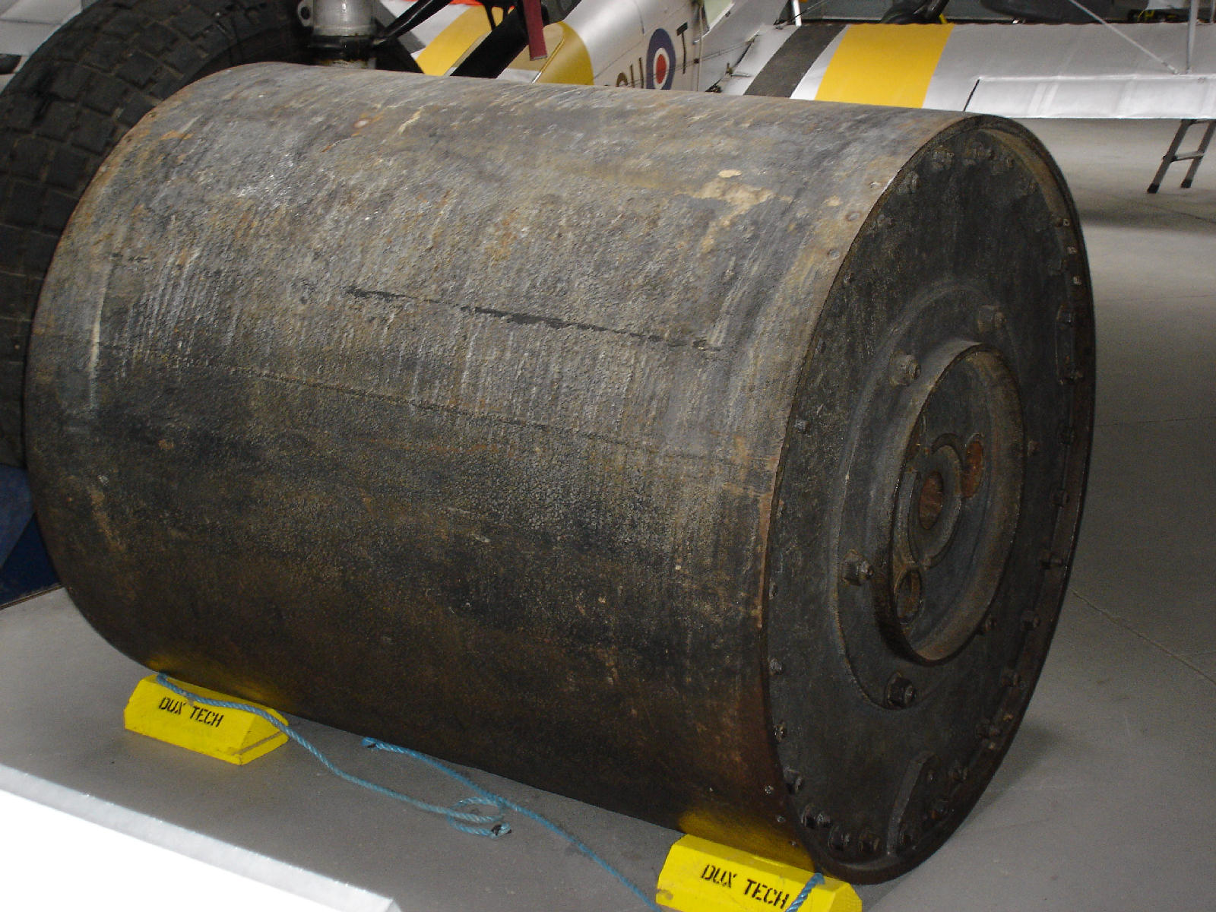
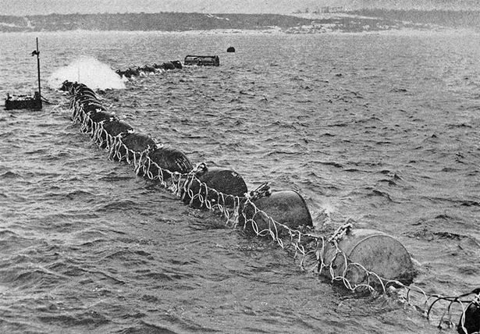
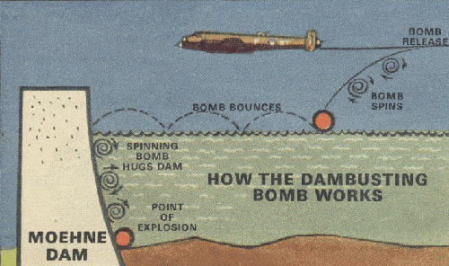
Lecture 6 - Angular Momentum and Torque

Slide 2
Recap of Last Lecture
Magnitude of angular momentum depends on the choice of origin
Angular Momentum
The magnitude of angular momentum is given by

Slide 3
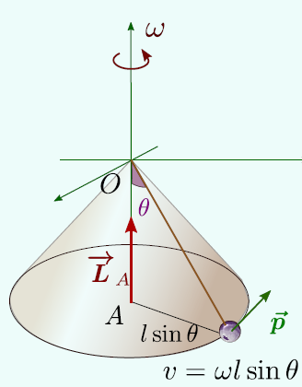
Angular Momentum – Conical Pendulum
Angular Momentum about the point A
Notes:
Please remember to tell the student that between l sine theta and mv it is a multiplication sign

Slide 4
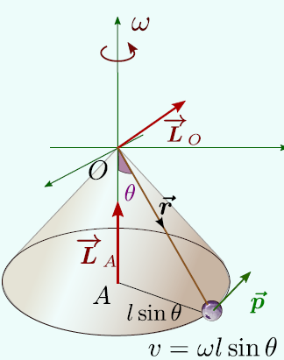
Angular Momentum – Conical Pendulum
Angular Momentum about the point O
Notes:
Work out these calculations manually on the board. Emphasize on the point that magnitude of L depends upon the origin we choose.

Slide 5
Angular Momentum and Torque
Rate of change of angular momentum is Torque
Change in angular momentum might be either in magnitude or direction or both
=0
Notes:
Derive the equation on the board. Use volunteer to demonstrate using the wheel that there can exist a torque when net force is zero or the force can exist and the torque can still be zero.

Slide 6
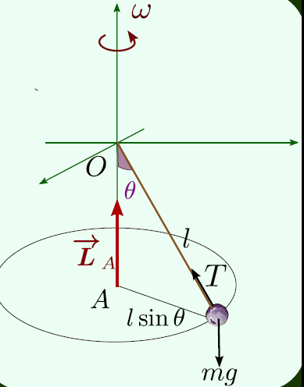
Change in direction of Angular Momentum and Torque
Torque about point A is Zero
Why?
Torque about point 0 is
non zero
Force T sinθ provides the centripetal force
Force T sinθ and moment arm l cos θ are perpendicular
Notes:
Show gyroscope example if possible. Tell them how the magnitude and direction of angular momentum did not change when A is taken as the origin . Torque due to gravity and T cos theta cancels each other out. Only the component T sin theta provides centripetal acceleration.

Slide 7
Change in direction of Angular Momentum and Torque
Torque
We know
Therefore

Slide 8
Change in direction of Angular Momentum and Torque
dθ
L(t+dt))
Ldθ
L(t)
ω_{p} is called the precession frequency or the frequency with which the angular momentum vector rotates

Slide 9
Change in magnitude of Angular Momentum and Torque
y
r
l
τ
v
x
f
L(t)
y
r
l
τ
v
x
L(t+dt)
f

Slide 10
Angular Momentum and Torque
Rate of change of angular momentum is Torque
Change in angular momentum might be either in magnitude or direction or both
=0
Notes:
Derive the equation on the board. Use volunteer to demonstrate using the wheel that there can exist a torque when net force is zero or the force can exist and the torque can still be zero.

Slide 11
Change in direction of Angular Momentum and Torque
Torque about point A is Zero
Why?
Torque about point 0 is
non zero
Force T sinθ provides the centripetal force
Force T sinθ and moment arm l cos θ are perpendicular
Notes:
Show gyroscope example if possible. Tell them how the magnitude and direction of angular momentum did not change when A is taken as the origin . Torque due to gravity and T cos theta cancels each other out. Only the component T sin theta provides centripetal acceleration.

Slide 12
Change in direction of Angular Momentum and Torque
Torque
We know
Therefore

Slide 13
Change in direction of Angular Momentum and Torque
dθ
L(t+dt))
Ldθ
L(t)
ω_{p} is called the precession frequency or the frequency with which the angular momentum vector rotates

Slide 14
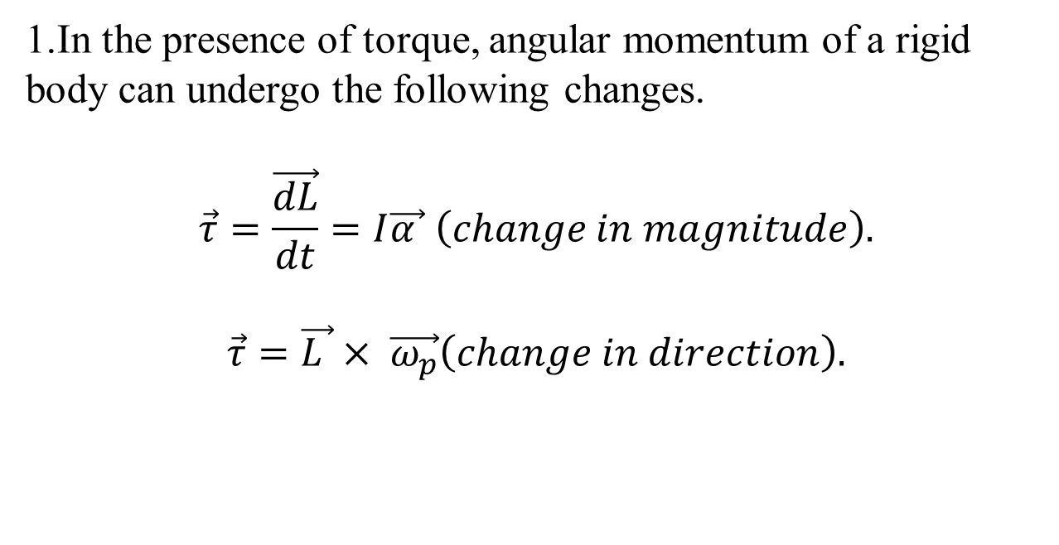
Summary
1.In the presence of torque, angular momentum of a rigid body can undergo the following changes.
$$\vec{τ}=\frac{\vec{dL}}{dt}=I\vec{α } \left(change in magnitude\right).$$
$$\vec{τ}=\vec{L }× \vec{ω_{p}}\left(change in direction\right).$$
2. Depending upon the origin we choose, torque can be zero or non-zero. i.e, the magnitude of torque depends on the origin we choose.

